Slide 1
WELCOME
Winter 2025 Orientation

Slide 2
Happy National Mentor Month
Thank You, Mentors & Mentees!

Slide 3
ACE Program Info
Created under the university’s first female president, Kimberly Andrews Espy (2024), “College to Career” initiative
Designed to increase mentorship for all undergraduate business students
Six Business Majors & Two Minors
Mentorship program in the Wayne State University, Mike Ilitch School of Business – Ilitch School Career Services
Uplifting. Empowering. Transforming.

Slide 4
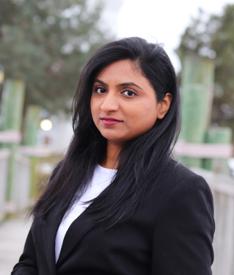
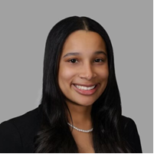
The ACE Administrative Team
Bianca Fielder
Program Administrator
Sayali More
Program Administrator Assistant/
IT Specialist
Kaiya Scott
Program Administrator Assistant/ Marketing Specialist

Slide 5
Our Mission
Empower your career journey
Equip you with the tools, knowledge, and connections to thrive in your career
Industry Insights
Career Development
Skill Enhancement
Networking Opportunities
Encouraging a growth mindset
Uplifting. Empowering. Transforming.

Slide 6
Program Goals
Personal Growth: Support mentees in developing self-confidence, resilience, and self-awareness
Networking Opportunities: Build professional relationships that enhance career growth and networking opportunities by connecting students with experience professionals.
Career Development: Bridge the gap between academic knowledge and real-world experience.
Skill Enhancement: Provide guidance on essential business skills.
Industry Knowledge: Offer mentees a deeper understanding of current trends, challenges, and best practices in the business world.
Transition Support: Help students smoothly transition from academic environments to professional careers
Uplifting. Empowering. Transforming.

Slide 7
Mentors’ Responsibilities, Expectations & Benefits
Build a Positive Mentor-Mentee Relationship
- Establish and Maintain Trust & Confidentiality
- Maintain Regular Communication
- Set the standards
Provide Guidance & Support
- Career Advice/ Skill Development
- Goal Setting
- Industry Insights
- Share Experience & Knowledge
Offer Constructive Feedback
- Performance Evaluation
- Encouragement and Support
Legacy & Impact
- Leadership Development
- Lessons from Personal Experience
- Building Professional Reputation
Uplifting. Empowering. Transforming.

Slide 8
Mentees’ Responsibilities, Expectations & Benefits
Actively Learn & Grow
- Initiate the mentorship
- 1:1 Career Guidance
- Continuously Learn
- Grow Professionally
Accept Realistic Feedback & Guidance
- Be Open to Constructive Criticism
- Follow Guidance for Professional Development
Actively Participate in Professional Networking & Exposure
- Expand Your Professional Network
- Learn from Diverse Experiences
Goal-Oriented Focus
Identify realistic professional goals and achieve them
Uplifting. Empowering. Transforming.

Slide 9
Key Program Points
Personalized Online Matching
Monthly Meetings
Ongoing Support
Goal setting and accountability
Personal & Professional Growth
Uplifting. Empowering. Transforming.

Slide 10
Program Milestones & Meeting Timelines
January - Engagement Meeting: Program Kickoff & Goal Setting
February - Development Meeting: Skill Development Focus (Resume & Networking)
Mid-point Check-in & Survey
March - Acceleration Meeting: Career Exploration (Job shadowing, Informational Interviews, Network exposure, etc.)
April - Wrap- Up Meeting: Final Check-in & Career Planning
Final Survey

Slide 11
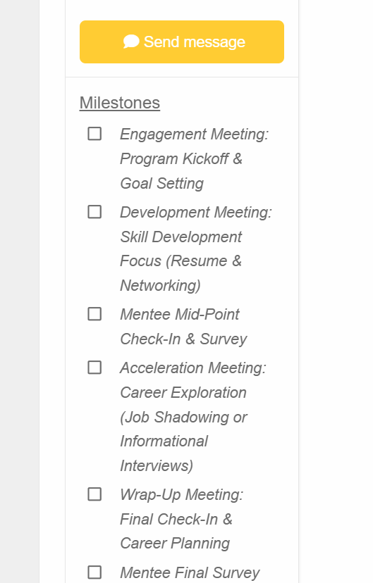
Connections to Milestones

Slide 12
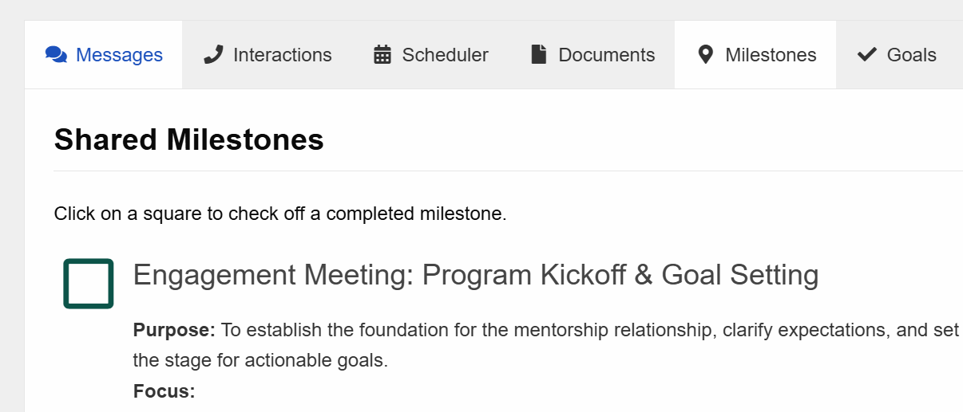
All things Xinspire & Checking Off Milestones

Slide 13
Mentorship Matters Happy Connecting!
Questions?
Contact us at acementorship@wayne.edu

